Slide 1
BEE – Control Board Requirements v1.6
17 October 2025

Slide 2
BEE – Background and Project Objective
In industrial applications lower lubricant concentrations are becoming more and more crucial. The increasing amount of automation in production, along with the number of small assembly and handling stages and the development of machines and components that require less lubrication, are the causes. Therefore, multi outlet compact lubrication system has huge potential.
The objective is it to develop a small pump with up to 6 outlets that can be either directly connected or used in small ALS. A cable as well as battery version must be realized. A cartridge interface module in the pump shall ensure compatibility with different cartridge systems. To be competitive in future, a connectivity module will be necessary in a later version of the pump.

Slide 3
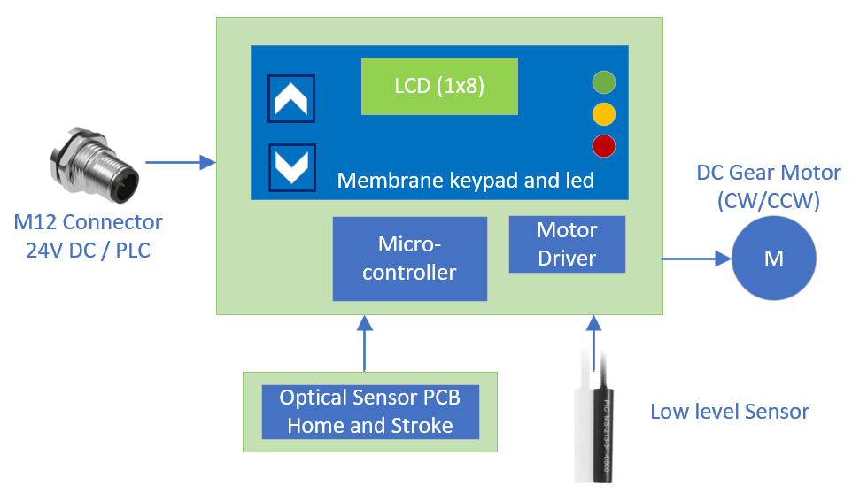
BEE – Control Board Requirements

Slide 4
BEE – Control Board Requirements
Specifications | Basic Direct Connection
Rated Voltage | 24 VDC
Operating Voltage | 24V DC (24 – 32V)
Control Type | Microcontroller or controlled by external PLC
Keypad | Membrane Keypad
Display | LCD / OLED
Led's | Status Indication (On the Membrane Keypad)
Connectors | Small footprint preferred
Motor control | DC Geared Motor (Planetary or Spur Gear)
Motor current | <1A
Low level sensor | Reed Switch
Home and Stroke position sensor | Hall sensor IC Optical Sensor – 3 No.
Pressure | 80Bar
External Power Input | M12x1, 4Pin Male
Battery input | No
Connectivity : LoRa WAN / Wi-Fi & Bluetooth | No
Batteries | No
Battery connector / holder | No
Battery to board cable and connector | No
Board Dimension | 50 (L) x 60 (W) mm
Operating Temperature | -20 to 70 °C
Annual Volume | 30000

Slide 5
BEE – Control Board Requirements
Sl No. | Features | Comments
1 | Display | LCD/OLED type display
2 | Input device | Pump settings – Membrane Keypad Home Position, Stroke and Single Line Relief – Optical sensor PCB
3 | Status Indication | Red – Empty/Failure, Yellow – In operation, Green – Standby
5 | Low level Sensor / Empty level Indicator | Miniature type Reed Switch ex: MS-213-3
6 | Pressure Sense | Pressure sense through load current measurement / Motor speed
7 | Protection required for the Pump | Inrush current, over voltage, over current, surge protection and reverse polarity protection

Slide 6
BEE – Control Board Requirements
Documents & Deliverables:
Quotation
Investment
Timeline
Deliverables (Refer Slide 8)
Compliance : Reach and RoHS, PFAS, EMI/EMC
Certifications : CE, FCC, UKCA, UL and Wireless Connectivity certifications (For connectivity version)
Note:
Connectors can be removed to meet the target cost, wires can be soldered directly to the board
LoRa communication will be 1st priority, provision for Bluetooth and Wi-Fi connectivity shall be provided in the board for connectivity version
Various Input and display options to be explored and best option shall be selected for BEE
Multiple battery options shall be suggested
Additional HW or SW features other than the standard requirement can be proposed as delighters
Different DC motor options shall be explored with 1.5 to 2Nm torque and 60 RPM
User friendly PLC communication shall be used for basic version
Identify and propose reliable battery adapter and charger source
Membrane sticker with Keys and led must be provided

Slide 7
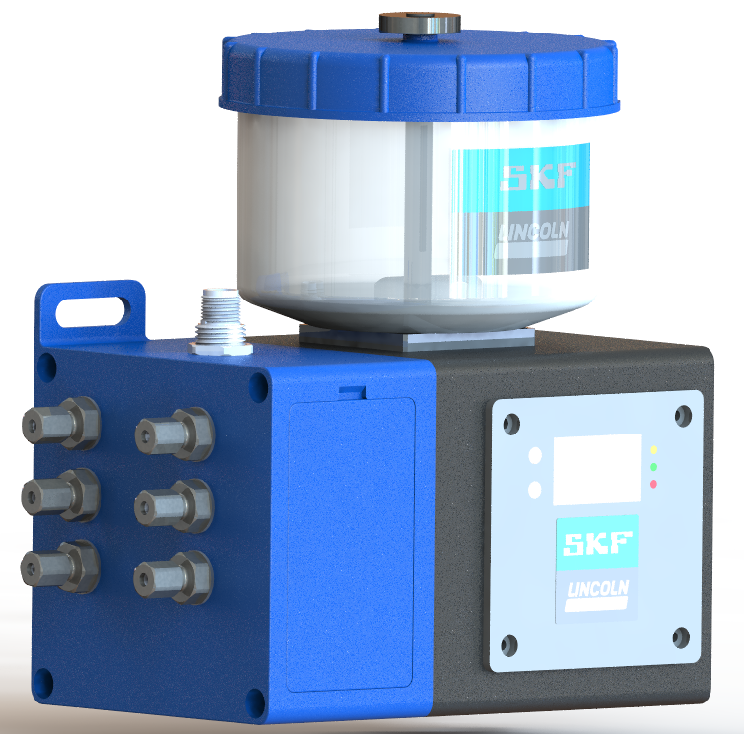
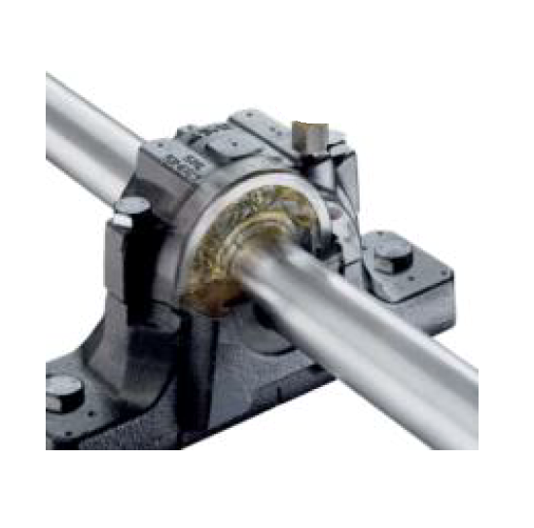
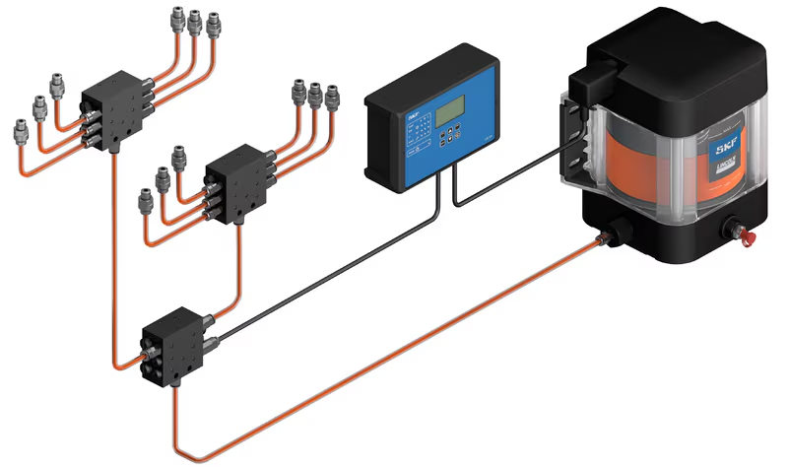
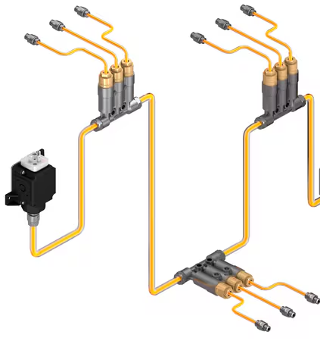
Release phase & Max nr pump strokes
Single-point Lubricator
Not NEEDED
1 – 15 strokes per lube cycle
Multi-point Lubricator (2 to 6)
NEEDED
6 strokes per lube cycle
Progressive System
Not NEEDED
1 – 15 strokes per lube cycle
Single Line System
NEEDED
1 – 15 strokes per lube cycle
4 possible USEs

Slide 8
Control unit
Single-point Lubricator
BEE is always equipped with an integrated control unit which enables:
Lube cycle set-up in the pump (by end user at any time)
Alarm due to empty reservoir and power peak
Several modes to distinguish between Stand-alone controlling or machine PLC controlling
Several modes to distinguish between different USEs
Multi-point Lubricator (2 to 6)
Progressive System
Single Line System
4 possible USEs

Slide 9
Reduced Variant 1
1 pump – 1 USE
Modes: “Single-point Lubricator”
Lubrication Cycle: defined at BEE controller
Run time: 1 -15 pump strokes
Pressure release: not needed
Pause time: up to 100 hours (min 1 hour) Lubrication cycle memory at BEE: YES
Single-point Lubricator
Reduced Variant 2
Reduced Variant 4
Modes: “Multi-point Lubricator – Stand alone”
Lubrication Cycle: defined at BEE controller
Run time: 6 pump strokes (fixed)
Pressure release: NEEDED
Pause time: up to 100 hours (min 1 hour)
Lubrication cycle memory at BEE: YES
1 pump – 1 USE
1 pump – 1 USE
Modes: “Progressive pump – Stand alone”
Lubrication Cycle: defined at BEE controller
Run time: 1 -15 pump strokes
Pressure release: not needed
Pause time: up to 100 hours (min 1 hour)
Lubrication cycle memory at BEE: YES
Multi-point Lubricator (2 to 6)
Progressive System
Reduced Variant 3
Reduced Variant 5
Modes: “Multi-point Lubricator – PLC control”
Lubrication Cycle: defined at machine PLC*
Run time: 6 pump strokes (fixed)
Pressure release: NEEDED
Pause time: up to 100 hours (min 1 hour)
Lubrication cycle memory at BEE: NO
1 pump – 1 USE
1 pump – 1 USE
Modes: “Progressive pump – PLC control”
Lubrication Cycle: defined at machine PLC*
Run time: 1 -15 pump strokes
Pressure release: not needed
Pause time: up to 100 hours (min 1 hour)
Lubrication cycle memory at BEE: NO
Multi-point Lubricator (2 to 6)
Progressive System
* Turning on and off the BEE power supply

Slide 10
Reduced Variant 6
Modes: “Single Line pump – Stand alone”
Lubrication Cycle: defined at BEE controller
Run time: 1 -15 pump strokes
Pressure release: needed
Pause time: up to 100 hours (min 1 hour)
Lubrication cycle memory at BEE: YES
1 pump – 1 USE
Single Line System
Reduced Variant 7
Modes: “Single Line pump – PLC control”
Lubrication Cycle: defined at machine PLC*
Run time: 1 -15 pump strokes
Pressure release: needed
Pause time: up to 100 hours (min 1 hour)
Lubrication cycle memory at BEE: NO
1 pump – 1 USE
Single Line System
* Turning on and off the BEE power supply

Slide 11
PLC control vs Stand-alone MODES
Lube Cycle defined and controlled at the Machine PLC
Run and Pause time set up (factory) at maximum values (15 strokes / 100 hours)
PLC controls BEE by turning on and off the power supply to BEE
Lubrication cycle starts from the beginning every time that BEE is turn on (NO “MEMORY”)
OEM or SH check if run time (nr of strokes) should be reduced in order to avoid unnecessary over-pressure (after testing, it is confirmed that less than 15 pump strokes are required) and adjust number of strokes at the BEE controller accordingly
OEM or SH can make BEE run continuously for the initial filling of the ALS. Start-up time is set up at the machine PLC. BEE runs during that time alternating maximum number of strokes (15) and motor-minimum pause time (5 minutes)
Alarm signals from BEE (level switch or electrical peak) is transmitted to machine PLC as just one alarm signal
Pressure switch (Single Line pump) or Piston detector (Progressive) can be connected to machine PLC. Machine PLC turns power supply to BEE off once signal from Pressure switch or Piston detector is received, in order to finish the lubrication cycle
2 different ways of controlling the BEE
Lube Cycle defined and controlled at BEE controller – Stand Alone
Run and Pause time set up at BEE controller at any time by user
BEE just need power supply (24 V)
BEE controller has “MEMORY”. If run time or pause time is interrupted, the lubrication continuous at the point where the pump function was interrupted. Pump does not start a new lubrication cycle.
End User uses “start up” mode for the initial filling of the ALS, which enables BEE to run continuously. alternating maximum number of strokes (15) and motor-minimum pause time (5 minutes) during 1 hour (around 30 lubrication cycles)
Alarm signals (level switch or electrical peak) are visualized at BEE controller display
Pressure switch (Single Line pump) or Piston detector (Progressive) cannot be used
Pre-requisite: AE must always check that maximum lubricant demand from whole ALS is < 2,25 cc

Slide 12

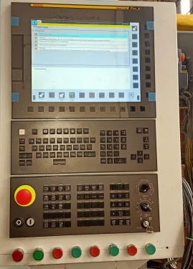
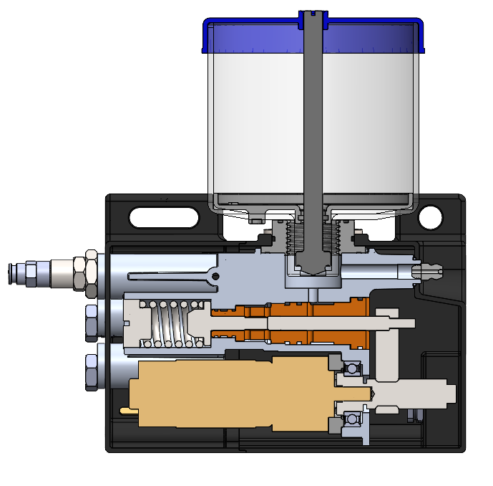
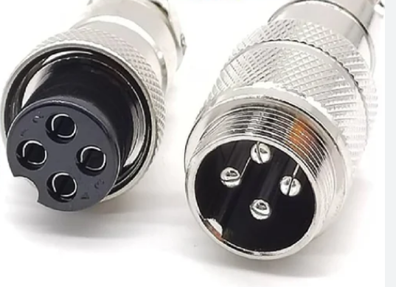
PLC control MODE
Feedback signal 24V DC to PLC
Machine PLC
Factory settings:
Single line mode
Max. Stroke 15
Pause time : 100 hours
BEE Pump
Pressure Switch
16 - 18 bar
Male pins in pump
Female pins from PLC
4 core cable:
Pin 1: Power 24V
Pin 2: Input to BEE controller
Pin 3 : Ground
Pin 4 : Input to PLC (Low level, Motor overload)

Slide 13
Passwords
Password 1
2 different Passwords for 2 different accessibility levels
Use when ALL modes are available
Run time and Pause time are adjustable at the BEE controller
It enables selecting just ONE mode. It is used by:
Bangalore factory: to select just one mode (Reduced Variant) which corresponds to the USE needed by the OEM or MaPro
System House: SH does not know while purchasing which specific USE will be required. SH purchases pumps for its own stock and apply case by case using different modes. Final mode is selected by the SH.
Password 2
Use when only ONE mode is available (after Password 1 has been used already to block the rest of modes)
It enables blocking any changes at the BEE controller. It can be used by:
OEM: because the machine PLC is actually controlling the Lubrication cycle (PLC control mode selected)
EU: in order to avoid that any operator might change the settings at the BEE controller by mistake

Slide 14
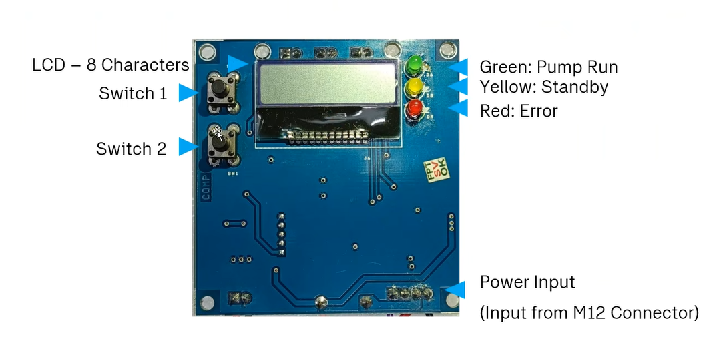
Display functionalities
BEE controller
Functionalities:
Mode selection & blockage of rest of modes (using password 1)
Blockage of BEE display (no one can change settings unless password 2 is entered)
Set-up of run time (strokes) and pause time

Slide 15
Display interface
BEE controller
LCD (8 characters) Display
3 LEDs to indicate status
Press Keys

Slide 16
Leds
BEE controller
Green: blinking during run time
Yellow: Led on during pause time
Red:
Blinking if low level (“LL” on screen
Led on if motor overload (“OL” on screen

Slide 17
Modes Acronyms
BEE controller
“SP”: Single-point Lubricator Stand-alone
“MP-SA”: Multi-point Lubricator Stand-alone
“MP-PLC”: Multi-point Lubricator PLC control
“PRG-SA”: Progressive system pump Stand-alone
“PRG-PLC”: Progressive system pump PLC control
“SL-SA”: Single Line system pump Stand-alone
“SL-PLC”: Single Line system pump PLC control

Slide 18
Mode as pre-requisite for Lubrication cycle set-up
BEE controller
By default, Multi-point lubricator Stand-alone is selected at the factory
By default, Run time (strokes) and Pause time are set-up at the factory at maximum values for both Stand-alone and PLC control modes*:
6 strokes for Multi-point lubricator / 15 strokes for rest of modes
Pause time 999 hours
* If mode is change from Multi-point mode to any other, strokes and pause time are set-up at maximum values

Slide 19
Mode selection (7 modes)
Password 1 setting
BEE controller
First Mode Selection
By default “BEE version X” appears on the screen
If mode is not change, by factory default – Multi-point Stand-alone is the pre-selected mode
Press “switch 1” key during 10 seconds.
“MODE” appears on the screen and after few seconds “MP-SA” appears blinking
Press Switch 1 and different modes blinking appearance on screen (is it key based /time based?)
When required mode appears on field, press switch 1 during 10 seconds (is long press for selection and why not key 2)
“password” appears blinking on screen
press switch 1 till first digit reaches wished number (0-9), then press switch 2 to select second digit. Once all 4 digits are selected, wait 5 seconds and password 1 will be saved and mode has been selected
Change Mode (after password has been created): (is this pause time and run time selection)
Press “switch 1” key during 10 seconds.
4 blank digits appear blinking on screen
Enter 4-digits password:
Press switch 1 to select number and switch 2 to move to next digit
Once all 4 digits have been entered, wait for 5 seconds
During 3 seconds “MODE” appears on screen and then the last mode blinking that was selected (is that 3 sec is part of 5 sec)
Press Switch 1 and different modes blinking appearance on screen
When required mode appears on field, press switch 1 during 10 seconds
“password” appears blinking on screen (is this password setting is required again if not can switch 2 used for selecting the mode)
press switch 1 till first digit reaches wished number (0-9), then press switch 2 to select second digit. Once all 4 digits are selected, wait 5 seconds and password will be saved and mode has been selected

Slide 20
Mode – Set-up Single-point Lubricator, Progressive System pump and Single Line System pump Stand-Alone
BEE controller
Run time Set-up (number of strokes):
Press once “switch 1”.
“Strokes” will appear on the screen for 3 seconds and then blank blinking screen appears during 10 seconds. If nr of strokes were previously set-up, number of strokes will appear on the screen for 10 switch seconds blinking
While blinking screen, press “switch 1” (increase) or “2” (decrement) in order to select the needed number of strokes
Once needed number of strokes is reached, wait 5 seconds and number of strokes stop blinking on the screen. Run time is now set-up
Re-start again the same steps if number of strokes needs to be modified
If number of strokes are modified during run time, new run time (strokes) will be driven in the next lubrication cycle (after the pause time)
Pause time Set-up (hours):
Press once “switch 2”.
“Pause T” will appear on the screen for 3 seconds and then blank blinking screen appears during 10 seconds. If pause time was previously set-up, it will appear on the screen for 10 seconds blinking
While blinking screen, press “switch 1” (increase) or “switch 2” (decrement) in order to select the needed pause time. Keep key pressed in order to accelerate.
Once needed pause time is reached, wait 5 seconds and screen will stop blinking. Pause time is now set-up
Re-start again the same steps if Pause time needs to be modified
If pause time is modified during pause time, new one will be driven in the next lubrication cycle (after run time)

Slide 21
Mode – Set-up Multi-point Lubricator Stand-Alone
BEE controller
Run time Set-up (number of strokes):
Run time in this mode is fixed (6 strokes) so if “Switch 1” is pressed there should be no reaction
Pause time Set-up (hours):
Press once “switch 2”.
“Pause T” will appear on the screen for 3 seconds and then blank blinking screen appears during 10 seconds. If pause time was previously set-up, it will appear on the screen for 10 seconds blinking
While blinking screen, press “switch 1” (increase) or “switch 2” (decrement) in order to select the needed pause time. Keep key pressed in order to accelerate.
Once needed pause time is reached, wait 5 seconds and screen will stop blinking. Pause time is now set-up
Re-start again the same steps if Pause time needs to be modified
If pause time is modified during pause time, new one will be driven in the next lubrication cycle (after run time)

Slide 22
Mode – Set-up Progressive System pump and Single Line System pump PLC control
BEE controller
Run time Set-up (number of strokes):
For these 2 modes, “Strokes” are set-up at maximum (15) by default at the factory. Use this maximal number of strokes for the first filling of the system
If strokes need to be changed press once “switch 1”. (what about the cycles, 1 stroke =Forword + reverse)
Maximum strokes (15) appears blinking on screen during 10 seconds.
While blinking screen, press “switch 1” (increase) or “switch 2” (decrement) in order to select the needed number of strokes
Once needed number of strokes is reached, wait 5 seconds and number of strokes stop blinking on the screen. Run time is now set-up
Re-start again the same steps if number of strokes needs to be modified
If number of strokes are modified during run time, new run time (strokes) will be driven in the next lubrication cycle (after the pause time)
Pause time Set-up (hours):
For these 2 modes pause time is by default set-up at factory at maximum pause time (999 hours) and cannot be changed.
For first filling of the system, PLC will control the BEE (power supply) making a minimum pause time of 5 minutes in order to protect the motor from burning

Slide 23
Mode – Set-up Multi-point Lubricator PLC control
BEE controller
Run time Set-up (number of strokes):
For these mode, “Strokes” are set-up at 6 by default at the factory. Use this maximal number of strokes for the first filling of the system
If strokes need to be changed press once “switch 1”. (in PLC mode is switch action needed?)
Strokes (6) appears blinking on screen during 10 seconds.
While blinking screen, press “switch 2” in order to reduce strokes, Maximum strokes for this mode is 6.
Once needed number of strokes is reached, wait 5 seconds and number of strokes stop blinking on the screen. Run time is now set-up
Re-start again the same steps if number of strokes needs to be modified
If number of strokes are modified during run time, new run time (strokes) will be driven in the next lubrication cycle (after the pause time)
Pause time Set-up (hours):
For these mode pause time is by default set-up at factory at maximum pause time (999 hours) and cannot be changed.
For first filling of the system, PLC will control the BEE (power supply) making a minimum pause time of 5 minutes in order to protect the motor from burning

Slide 24
First filling of the system All modes Stand-Alone
BEE controller
In order to enable a first faster filling of the system for Stand-alone modes, an exceptional shorter pause time (5 min) will be available. For it, Password 2 will be required. This exceptional pause time cannot be used as standard pause time (min 1 hour)
Press ““switch 2” key during 10 seconds.
“password” appears blinking on screen
press switch 1 till first digit reaches wished number (0-9), then press switch 2 to select second digit. Once all 4 digits are selected, wait 5 seconds and password 2 will be saved
To access to BEE controller settings, press “switch 2” during 10 seconds
Four blank digits will appear blinking.
Enter pre-created password using “switch 1” for selecting digit and “switch 2” to swift to next digit till all 4 digits of password have been entered. Wait 5 seconds and BEE controller will be accessible.

Slide 25
Mode – Set-up All modes Stand-Alone & PLC Control
BEE controller
Once selected the mode, values of strokes and pause time will appear on the screen during each phase decrementing

Slide 26
Password 2 setting All modes Stand-Alone & PLC Control
BEE controller
Password 2 is used to block access to BEE controller, so neither mode nor run/pause time can be modified
Press once “switch 2”.
“Pause T” will appear on the screen for 3 seconds and then blank blinking screen appears during 10 seconds. If pause time was previously set-up, it will appear on the screen for 10 seconds blinking
While blinking screen, press “switch 2” during 10 seconds. (need clarity)
4 blank digits appears on the screen blinking.
Enter Password 2 as usual: press switch 1 till first digit reaches wished number (0-9), then press switch 2 to select second digit. Once all 4 digits are selected, wait 5 seconds and “Pause TE” appears blinking on the screen for 3 seconds. Then blank blinking screen appears.
Enter exceptional pause time as usual

Slide 27
BEE – Scope and Deliverables
Scope of the project, deliverables, quotation and investment shall be mentioned in the SOW with reference to the requirement document.
Provide the complete proto development charges with break up. The SOW must specify all items in accordance with the scope and any exclusions.
Prototype quantity 10 no.
Pilot batch quantity 25 no.
Prototype development
Prototype board testing(Functional testing and system integration testing)
Pre compliance testing
Support for compliance and certification of BEE Pump (EMI/EMC, IP, Vibration)
Production test jig development and tool
Production testing
Packaging
Warranty terms

Slide 28
BEE – Scope and Deliverables
Sl No. | Requirements | Deliverables | Comment
1 | Technical specifications derived from requirement document | Technical Specification documentation | Acceptance criteria to be defined (Min and Max)
2 | Hardware design | Hardware design document (HDD) | Must be modularization approach
3 | Electrical Schematic design (with library) + pdf
4 | PCB layout design (with Library) + pdf
5 | Gerber Files ODB++
6 | BOM including • Quantity • Description • Order code • Manufacturer • Electrical schematic (PDF) • Component placement plan (PDF) • Gerber files • PCB stack-up •No of layers •Copper thickness •PCB thickness •Base material (e.g., FR2 / FR4) •PCB finish (chemical tin, chemical nickel/gold) •Test specification •Other specification (e.g., coating) | PCB zip folder including all the required files
7 | Firmware design | Software design document including flowchart (SDD) | Must be modularization approach
8 | Firmware design files | Firmware project zip folder | With documentation
9 | Programming procedure | Tool and necessary information required to flash the hex file
10 | Testing and validation - Controller board | Testing and validation report (DVT), Software Test Report
11 | Quality Plan | DFMEA Report
12 | Production test sequence | Firmware | Must be included in the main firmware
13 | Production Test jig | Complete Test Jig Design files | Total investment
14 | Compliance
 | • EMI/EMC pre compliance testing | Test Reports
 | • Reach and RoHS Certificate | Supplier declaration
 | • PFAS | Supplier declaration
 | • Lora Compliance | WPC Certification for India + Global Certifications | For Connectivity version (Future Scope)
 | • Bluetooth / Wi-Fi compliance | WPC Certification for India + Global Certifications | For Connectivity version (Future Scope)
15 | Packaging | Anti-static cover and corrugated box

